Slide 1
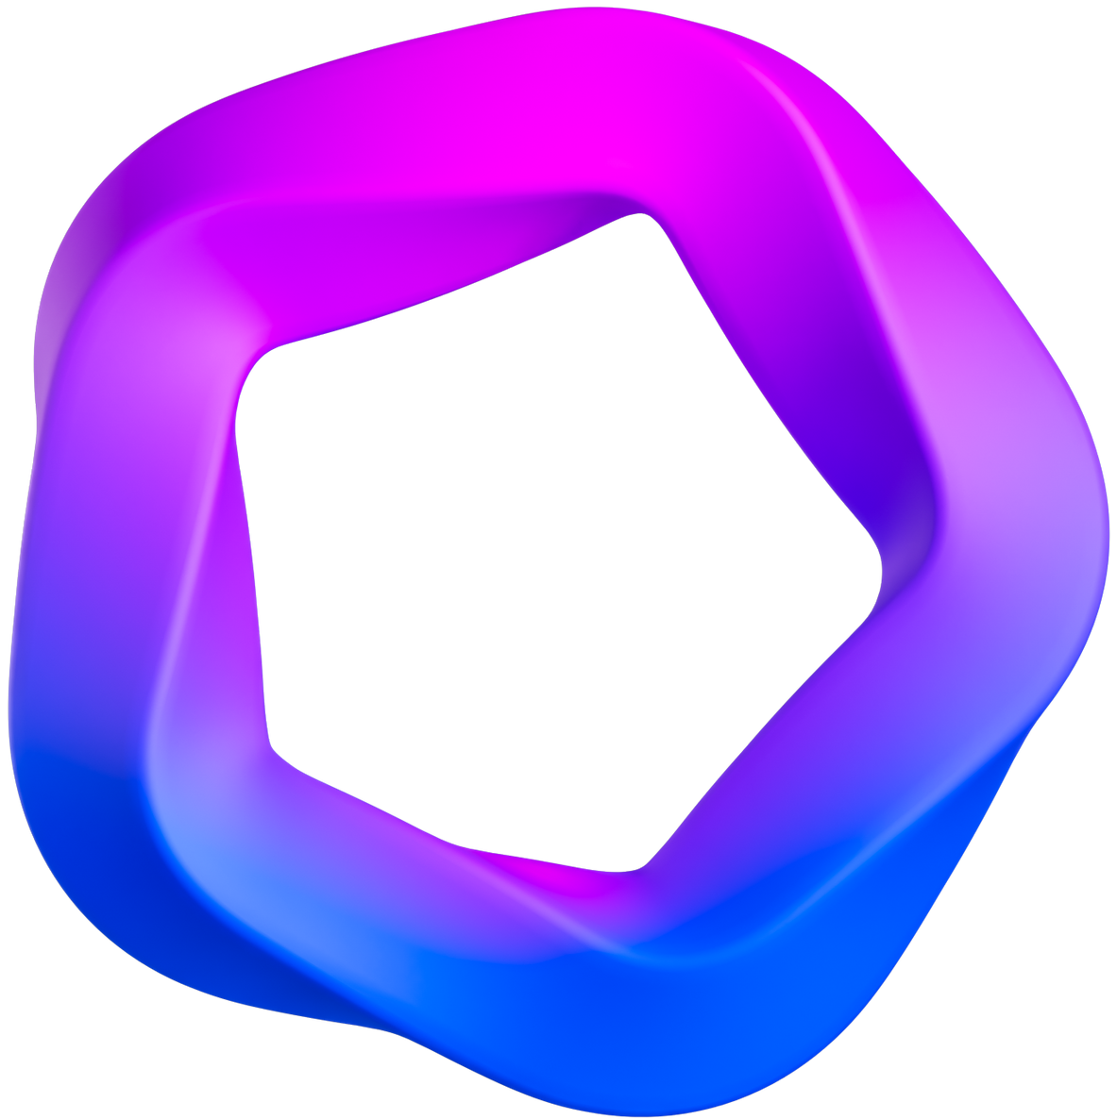
TechSolutions
Inc
Private Cloud, Delivered Locally

Slide 2
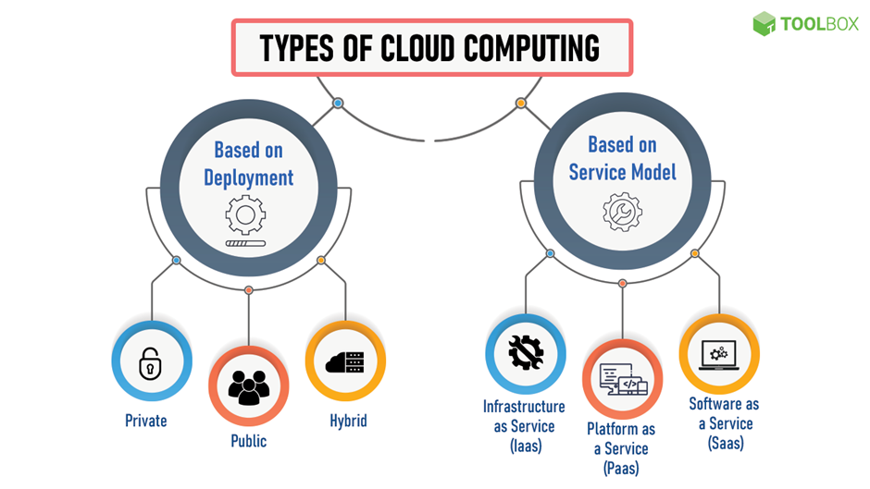

Slide 3
SMEs and Cloud
Small and medium enterprises (SMEs) are businesses with a limited number of employees and revenue, typically defined by thresholds that vary by country and industry.
Cloud technology enhances competitiveness through data-driven insights, flexibility in scaling operations, and fostering innovation with advanced tools like AI and IoT, while also bolstering collaboration and ensuring robust business continuity and security measures.
Cloud computing has revolutionized SME operations by offering efficiency gains, cost reductions, and scalable solutions without the burden of managing infrastructure.

Slide 4

About us
Founded in 2020
founded by John Wick, Tony Stark, and Natasha Romanoff in 2020 shortly after the pandemic, has quickly garnered 21 small clients across Ireland. The company, led by CEO Tony Stark with John as CFO and Natasha as CMO, has grown from a three-person startup to a prominent SME, employing 16 people and leveraging cloud services to help other SMEs upscale and improve.

Slide 5

Business
A small enterprise that supports emerging companies by catering to their specific needs and requirements. Utilizing their on-premises data centers and servers, they deliver public, private, and hybrid cloud services, focusing on Infrastructure as a Service (IaaS), Platform as a Service (PaaS), and Software as a Service (SaaS).
Hybrid cloud
Managed Hosting
Custom IT Infra
On-Prem Servers
Tech
Consulting

Slide 6
Target Market
Manufacturing compaies
Companies that require help in managing and storing inventory, bookkeeping, and other critical operations.
School
Schools and universities which required to store students' information and manage digital classes and resources post covid.
Healthcare Clinics
Small and medium healthcare clinics store patients’ sensitive data and healthcare compliance codes.
Small Firms
Small firms need to store sensitive data and resources and strictly control due to regulatory reasons.

Slide 7
Current IT Setup
Servers
Network Components
Security Components
Monitoring Tools
The server framework includes essential components like a CPU, RAM, storage drives, NICs, a stable power source, and a cooling system, supporting various applications with an Nginx HTTP server for web hosting, an application server, a PostgreSQL database for CRUD operations, and software for file storage, sharing, and data backup.
These components monitor the throughput of the system’s traffic by setting up various network protocols and other aspects such as different ports. They make sure that several appliances in the network are linked and the messages in the system are promptly transmitted inside the internal network.
To shield the whole infrastructure from malicious programs, the company has it installed with a robust anti-virus system, and an intrusion detection system to monitor for possible activities. They also maintain an authentication control and a delegation control system to control the access rights of each member properly.
Monitoring tools are also highlighted as an essential component that the company should implement. Some of the tools they use include Nagios for monitoring and alerting services for servers, switches, applications, and services. Also, they use Puppet to manage and automate the server picture.

Slide 8
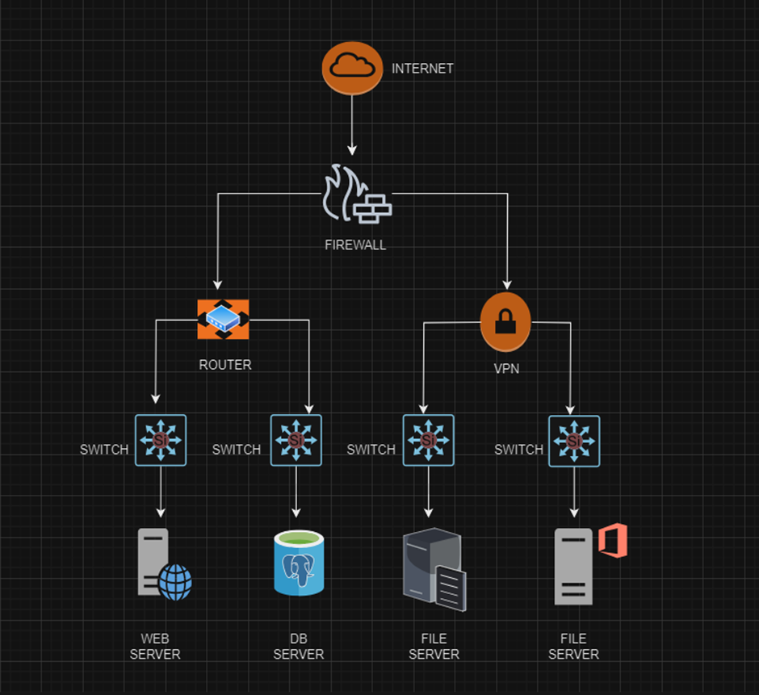

Slide 9
Scalability - When the demand for the company's software
solutions rises, the current on-premises infrastructure struggle
s with the increased load, causing performance issues and
longer deployment times. Onboarding new projects often
requires more computing power, but the current setup has
difficulty scaling resources quickly and providing remote access
to important documents and resources, leading to delays and
challenges for remote employees.
01
02
Disaster Recovery - The critical aspect of implementation and management is backups, as their absence can cause catastrophic data loss, but establishing an efficient backup management program is challenging and resource-intensive.
Issues
03
Cost & Energy Consumption - The servers deployed in large on-premises infrastructure environments are power hogs, and high energy costs lead to even higher project expenses.
04
Vendor Lock in - The organization could be disadvantaged by vendor lock-in for equipment, systems, and support, and while customization is possible, it can be very time-consuming and requires a certain level of expertise.

Slide 10
Moving To Cloud

Slide 11
Advantages
Increased Scalability
Improved Accessibility
Cloud infrastructure has accessibility as one of the marked strengths since employees can easily work from any location with an internet connection; this comes in handy with flexibility and productivity.
In cloud services, the company has the flexibility of expanding and even diminishing resources that are needed to perform their jobs based on the organization’s load with little capital outlay.
Cost Efficiency
Enhanced Disaster Recovery
Switching to the more flexible cloud pay-as-you-go system also allows the company to minimize capital investment on hardware and direct costs for their maintenance.
Disaster recoveries are typically built into the cloud through their platform, thus minimizing the prospects of data loss and the potential for operation disruption.

Slide 12
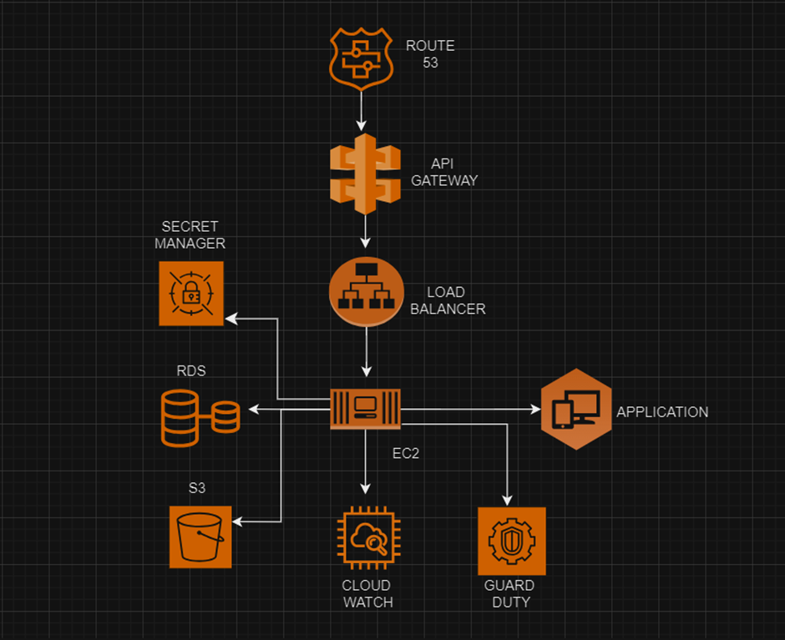
Recommended Infrastructure

Slide 13
AWS Services Used
Route 53
API Gateway
Load Balancer
EC2 Instance
Secret Manager
RDS
S3
Cloud Watch
Guard Duty

Slide 14
Thank you
Akhil Ajithkumar (20017759)
Pranjal Pathak (20020701)
Pratiksha Bhalerao (20034866)
Yashaswini Nagraj (20086302)

